Slide 1

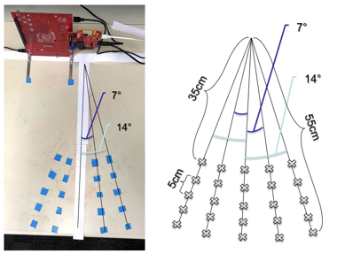

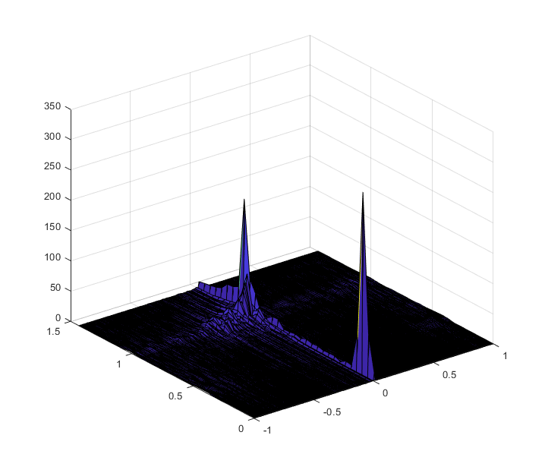
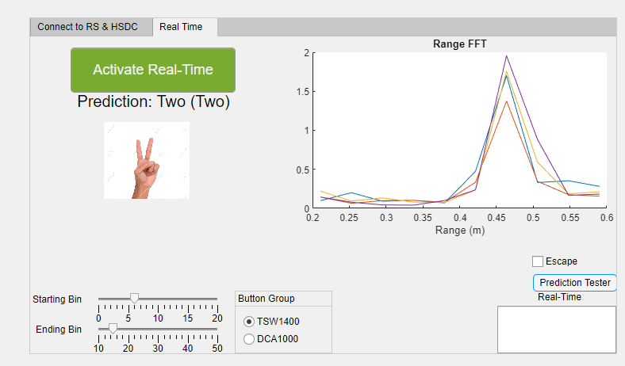
Real-Time Deep Learning Gesture Classification Models on mmWave Radar J. Smith, S. Thiagarajan, R. Willis, G. Balagopal, M. Torlak, Y. Makris The University of Texas at Dallas
OBJECTIVE:
Develop CNN deep learning-based algorithms for recognizing hand gestures from depth, azimuth angle, and velocity information provided by mmWave radar.
Set up a MATLAB-based real-time platform for gesture recognition.
APPROACH:
Leverage TI mmWave radar AWR1443 to collect large radar image datasets for each gesture class.
Perform initial range analysis on gesture data.
Preprocess to extract doppler velocity and azimuth cross-range information to enhance feature space of data prior to deep learning feature extraction.
Conduct kernel density estimation to approximate the probability density functions of multidimensional gesture data.
Develop highly accurate CNN architectures for gesture classification.
Use estimated density functions for each class to artificially enrich data pool and retrain CNNs.
Deploy a MATLAB-based platform for real-time gesture recognition using the pre-trained deep learning models.
Radar Spectrum
RESULTS:
Using kernel density estimation to enhance the data pool, static and dynamic gesture classifications can reach ~97% and ~100% accuracies, respectively.
Efficacy of the real-time platform demonstrates the feasibility of mmWave radar imaging for real-time high-accuracy image, pattern, and motion recognition.

